Slide 1

MInd Garden
A Serıous Game Platform for chıldren
Team Members:
Ali Kaan Göksu: 201511026
Emre Kasar: 201511038
Eyüp Taşkın: 201511059
Kazım Ataol Özüseven: 201411049
AdvIsor:murat saran

Slide 2
contents
AIM OF STUdy
Serıous games
Problems and solutıons
Sımılar projects
What ıs our dıfference?
Informatıons of the study
Project contrıbutıons
Technology used
Potentıal rısks
Success crıterıa
Project work plan
demo

Slide 3
AIm of Study
Create a digital platform containing serious games for children to enhance their capabilities of their motor skills.

Slide 4
Serıous games
What is a serious game ?
A game designed for a primary purpose other than pure entertainment.

Slide 5
Problems and SolutIons
Problem
SolutIon
Education is boring for some children.
Kids can spend a lot of time playing games.
Playing not inspected games for children could lead to serious harm in children’s psychology.
Serious games increases interests for education.
Limiting the time of gameplay avoids game addiction.
Designing games under the guidance of a pedagogue.

Slide 6


SImIlar Projects
MentalUp: Focuses on kindergarten children's mindset. It aims to help children develop their mental skills and discover their potential through fun brain exercises.
Toca Boca: The main goal for the company makes fun games for kids and keep children away from harmful games.

Slide 7
What is our Difference ?
Unlike other applications we have a time limit on our game to avoid game addiction.
It is not the player who determines the difficulty of the game, game has adaptable difficulty based on player’s performance.

Slide 8
InformatIons of the Study
Definition: Develop a digital game platform containig serious games.
Designed for children in ages 7 – 11.
Compatible in Android and IOS.
Main Features
Series of serious games.
Rewarding system.
Adaptable difficulty
Constraints
All game components should be child friendly.
Limited screen time.

Slide 9
Project ContrIbutIons
Enjoyable and efficient way of education.
2D child friendly environment. Environment contains a mascot to show and teach how to use UI of the application.
Change mascot’s appearances by using rewarding system.
Storing data of the players to observe the progress.

Slide 10




Technology Used
Unity Game Engine
Photoshop CC
Adobe Illustrator CC
Visual Studio Community

Slide 11
PotentIal RIsks
Occured Problem | Reason | Solution | Priority
Bugs and failures in game | Unexpected input | Debug and control random generated input | High
User interface is complicated and dull | Tutorial is not enough and environment is not interesting for kids. | Improve tutorial and redesign game environment. | Medium
Reward system is not satisfying | Rewards are not intresting | Gathering unique assets for rewards | Medium

Slide 12
Success CrIterIa
Success Criteria | How to Measure
Succesfull operating games | Usability Test
Attention of children is positive | Survey with users
Properly gathering and analyze the data | Observing users in a period of time
Understandable and usable user interface | Survey with users

Slide 13
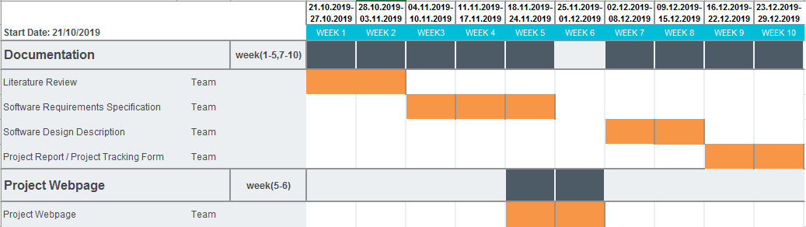
Project Work Plan
Gantt Chart of CENG407

Slide 14
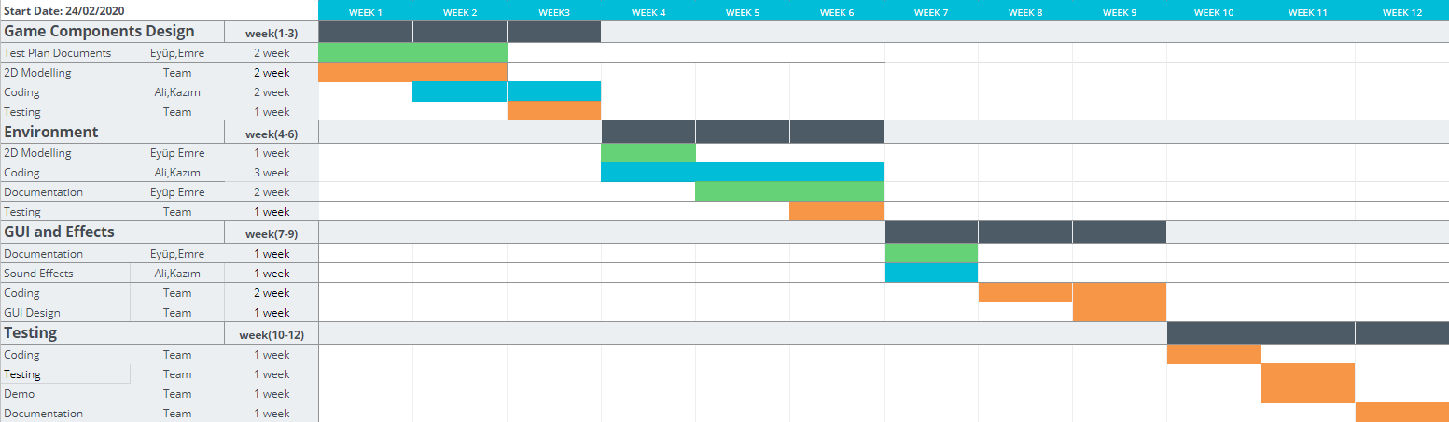
Project Work Plan
Gantt Chart of CENG408

Slide 15
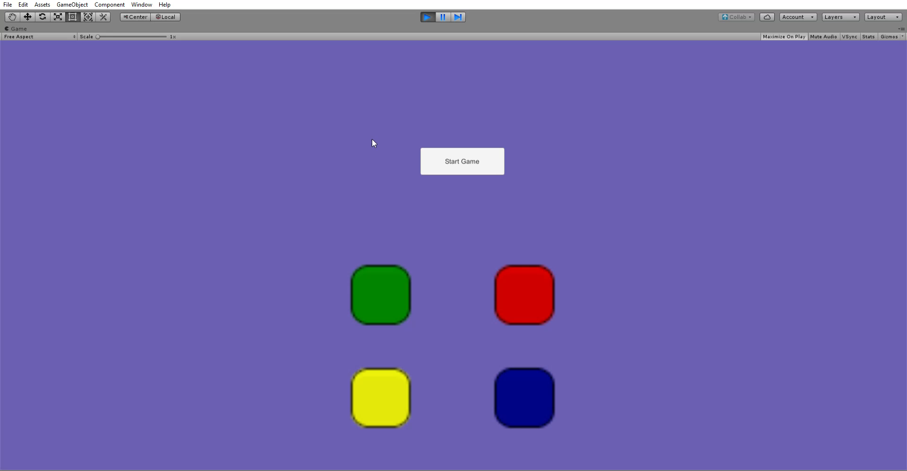
Sımon Says Demo

Slide 16
Acknowledgement
We are grateful to:
Murat SARAN, Assist. Prof. Dr.
Arman Demirci, Psychologist M.S.
We appriciate the guidance and attention.

Slide 17
Thank you.
QuestIons ?

